Slide 1



Quantitative Optical Coherence Elastography as an Inverse Elasticity Problem
Presenter: Li Dong (PhD student)
Rensselaer Polytechnic Institute
Authors: Li Dong (RPI), Philip Wijesinghe (UWA), James Dantuono (RPI), David Sampson (UWA), Peter Munro (UCL, UWA), Brendan Kennedy (UWA), and Assad Oberai (RPI)
February 14, 2016, Optics Elastography and Tissue Mechanics III, BiOS, Photonics West, SPIE.
Notes:
Spell out names, phd student

Slide 2
Outline
Elastography background
Inverse elasticity problem
Solution strategy
Experimental validation cases for quantitative OCE
Summary

Slide 3
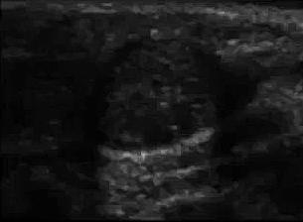
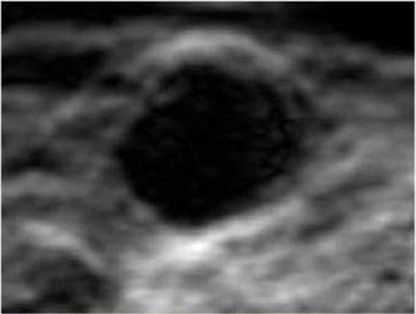
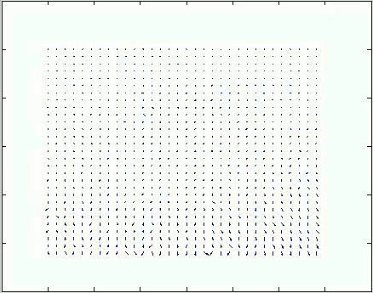
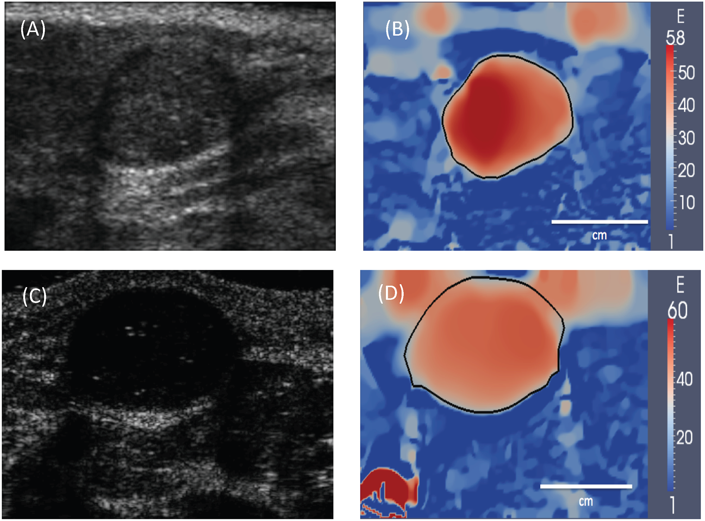
Elastography background
US B-mode (Hall, UW)
Imaging modalities, such as ultrasound, OCT, MRI, etc.
Estimate disp., such as image cross correlation
Strain
Differentiate
Normalized Young’s modulus
☑Inverse Problem
Liu, Oberai, et al. PloS one, 2015.

Slide 4
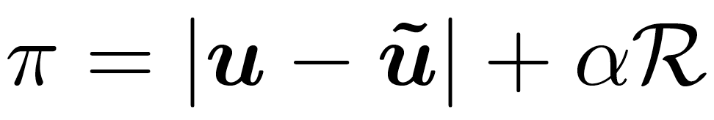
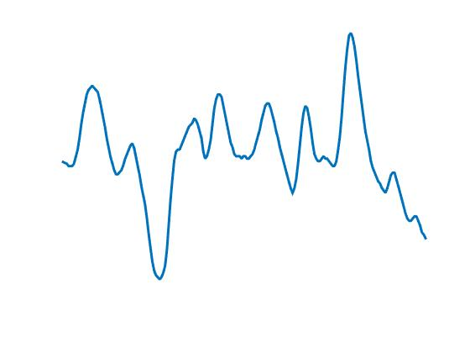
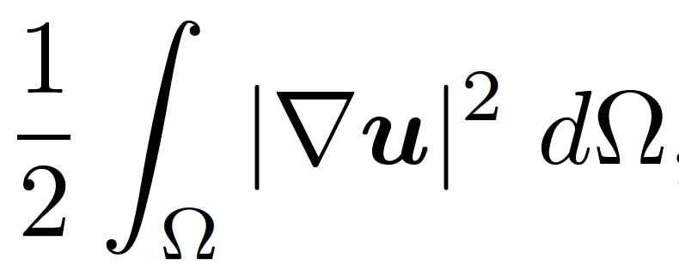
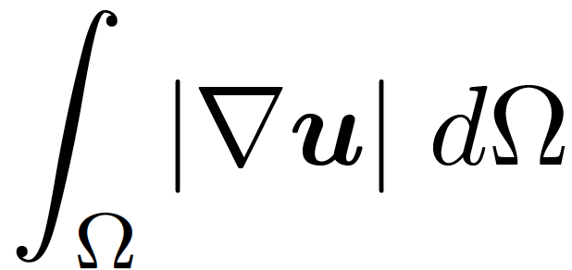
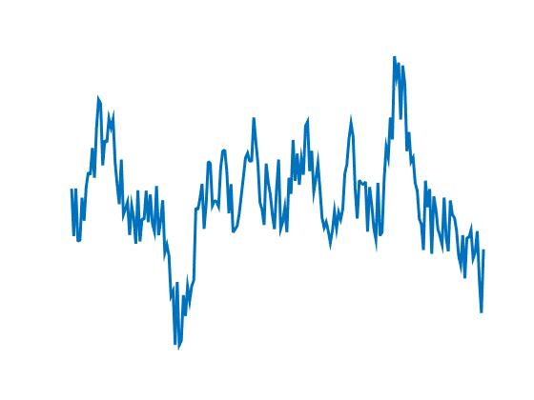
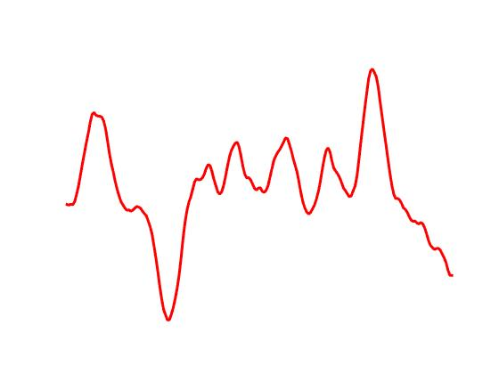
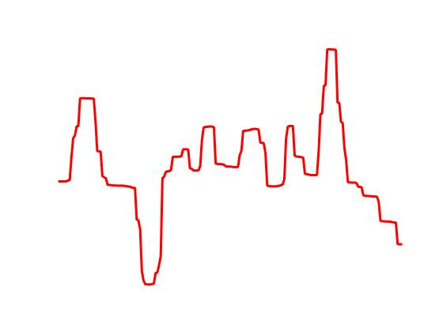
Inverse elasticity problem
Quasi-static equilibrium for linear elasticity:
?
Direct method
?
Optimization method
☑
Tikhonov
Total Variation (TV)
☑
Add noise
ũ
Apply regularization
u
Tikhonov
TV
Notes:
Explain all variables

Slide 5
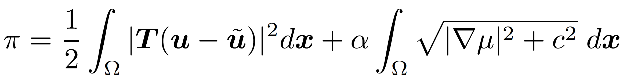
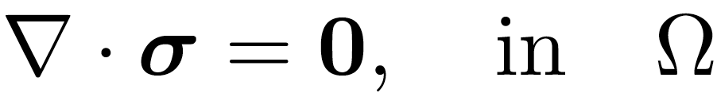
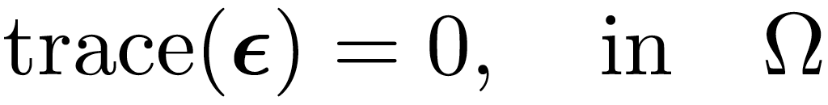
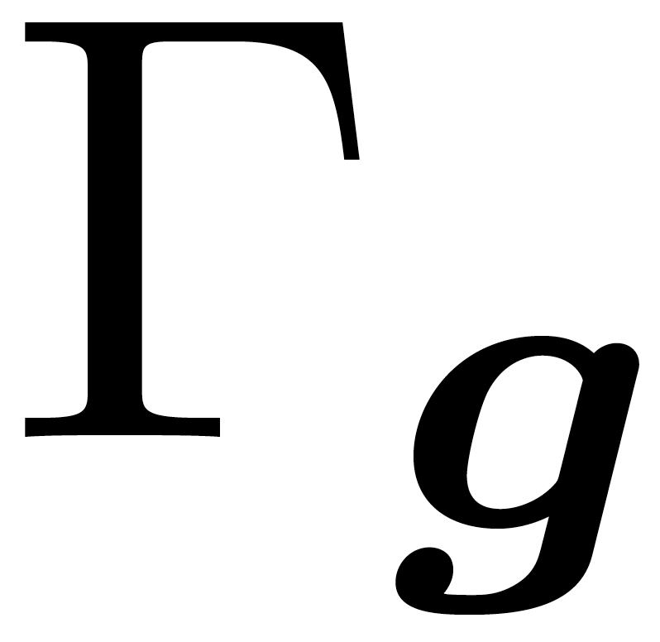
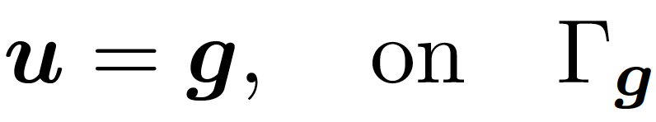
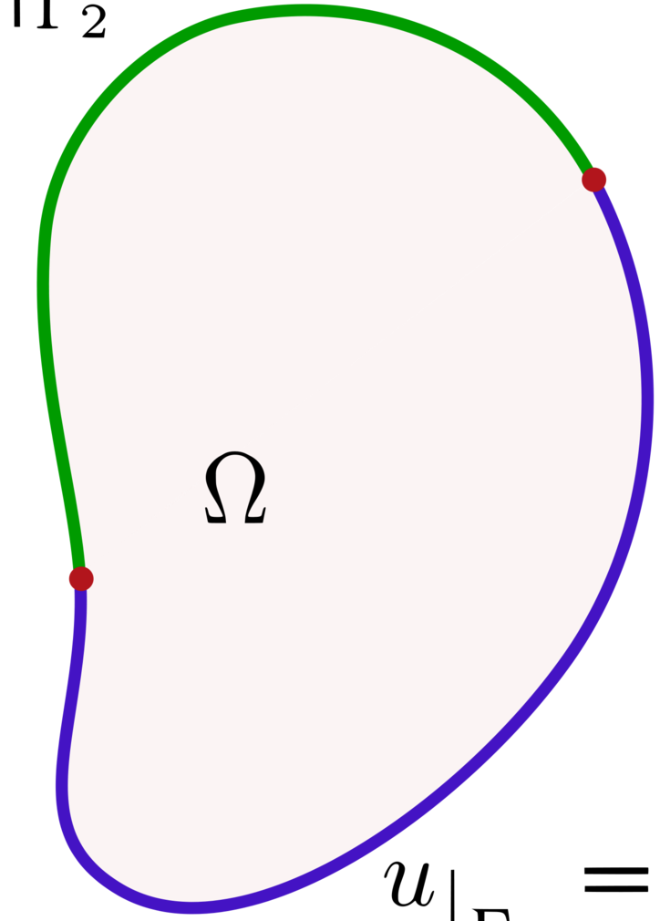
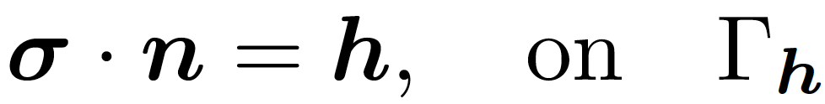
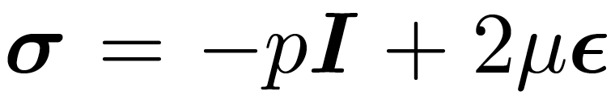
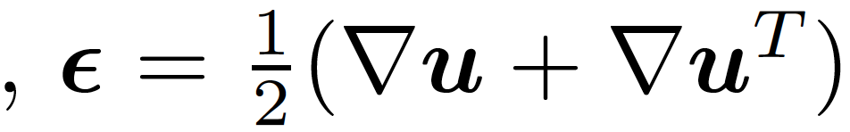
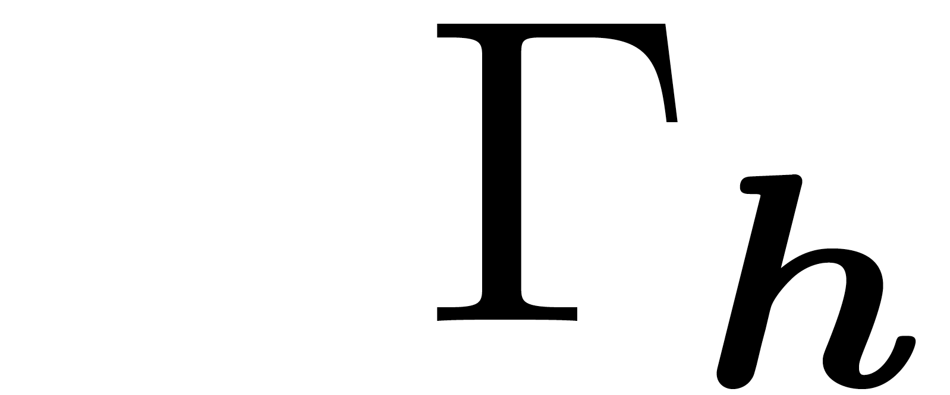
Solution strategy
PDE-constrained optimization
Find the shear modulus distribution μ that minimizes the cost function:
subject to
Two PDE constraints
BCs for the PDE constraints
where

Slide 6
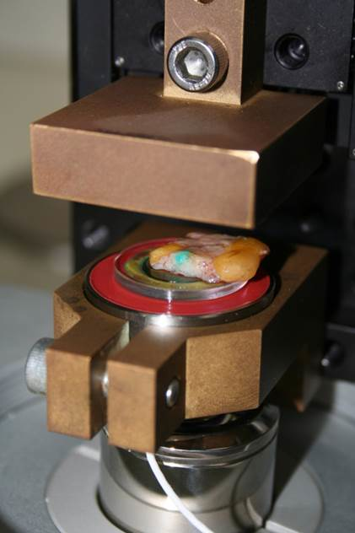
Solution strategy cont.
BCs:
U_{x}=0, U_{y}=ũ (and U_{z}=0)
Calibration layer
Sample layer
Traction free on x (and z), U_{y}=ũ
Quasi-static
Linear elasticity
Incompressible
Plane strain in 2D

Slide 7
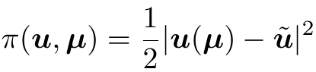
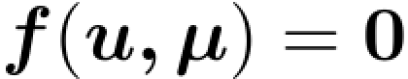
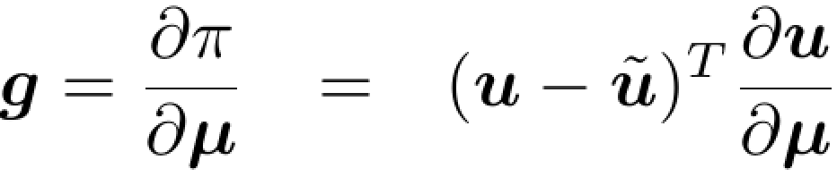
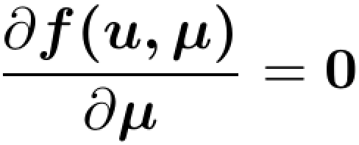
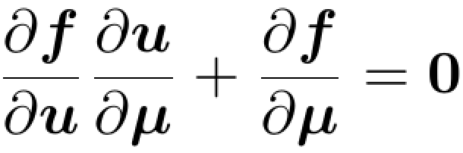
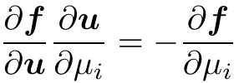
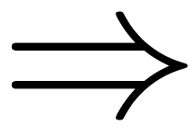
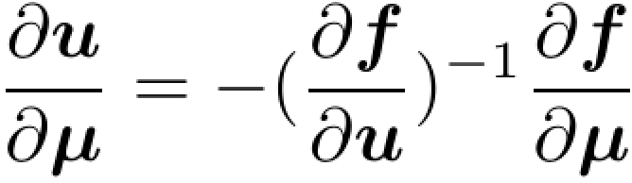
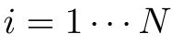
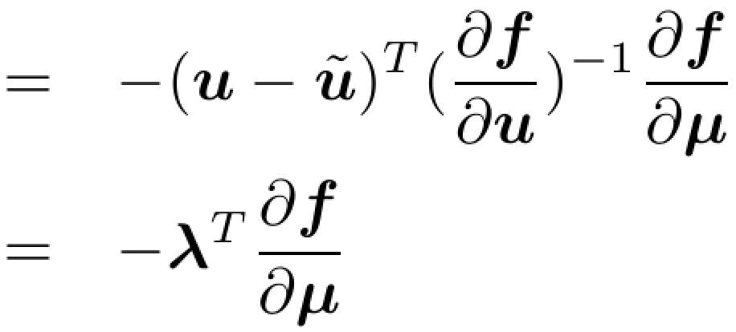
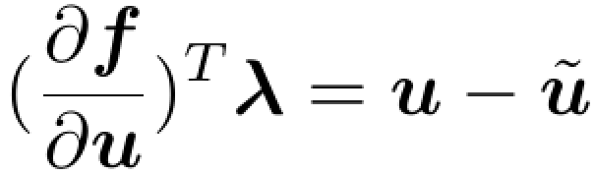
Solution strategy cont.: adjoint method
subject to
MxM * Mx1
Mx1
MxM * MxN
MxN
Naïve way
Adjoint way
where

Slide 8
Case I: Tissue-like phantom in 2D
OCT
500μm
Displacement
Strain
Shear modulus
9.3 kPa vs 10.6 kPa
1.9 kPa vs 2.2 kPa
52,150 optimization variables, terminate after 2,525 iterations.
Notes:
300x350=105000 points, 982x3500 microns, axial by lateral.
For the inclusion case, it takes about 17 hours to finish the case with optimal regularization parameter(3e-3), terminating at 2525th iteration.
All results are obtained from the linux platform with 8-core 2.3GHz Opteron processor and 16 GB memory.
Erase arrows

Slide 9
Case II: Equine bronchus in 2D
M: mucosa, ASM: airway smooth muscle, C: cartilage
500μm
OCT
Displacement
Strain
Shear modulus
Dong, L., Wijesinghe, P., Dantuono, J.T., Sampson, D.D., Munro, P.R.T., Kennedy, B.F., and Oberai, A. A. “Quantitative Compression Optical Coherence Elastography as an Inverse Elasticity Problem.” IEEE Journal of Selected Topics in Quantum Electronics. 2016. In press.
1.9 kPa
26,379 optimization variables, terminate after 6,000 iterations.
Dong, L., et al.. “Quantitative Compression Optical Coherence Elastography as an Inverse Elasticity Problem.” IEEE Journal of Selected Topics in Quantum Electronics. 2016. In press.
Notes:
160x440=70400 points, 524x4400 microns, axial x lateral.
For the tissue case, it takes about 30 hours to finish the case with optimal regularization parameter(1e-3), terminating at max (6000) iteration.
All results are obtained from the linux platform with 8-core 2.3GHz Opteron processor and 16 GB memory.

Slide 10
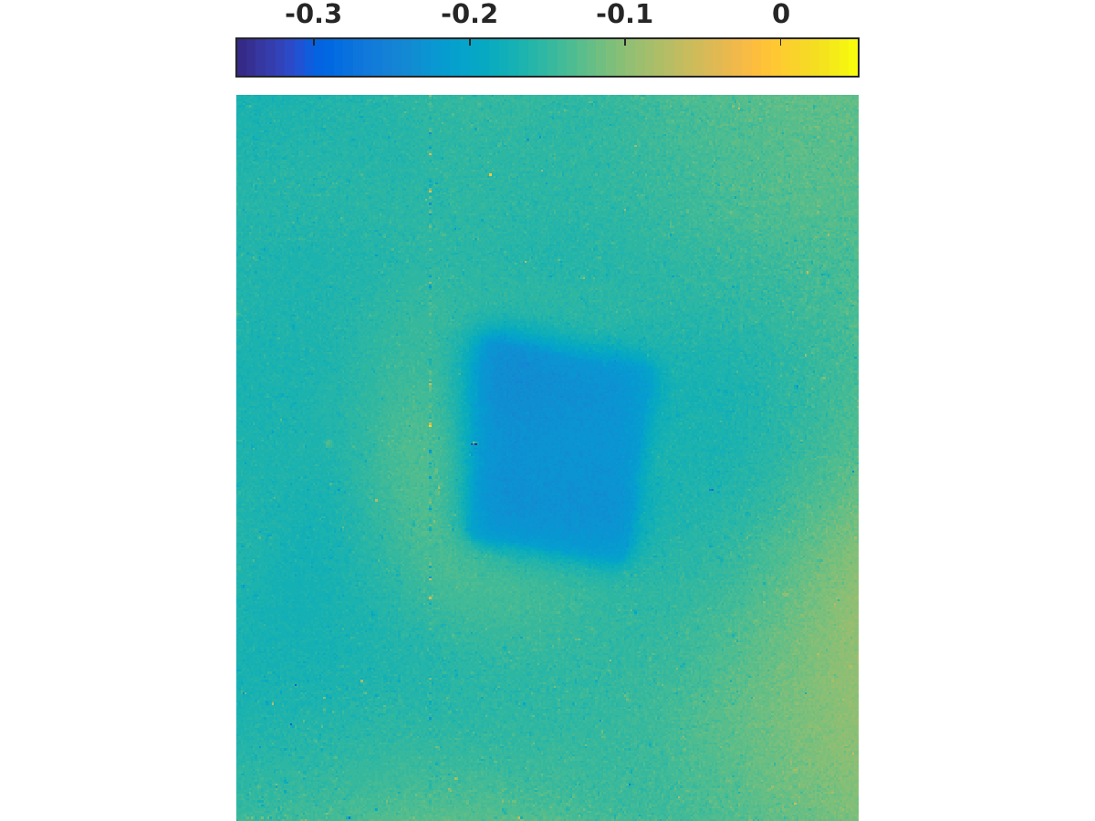
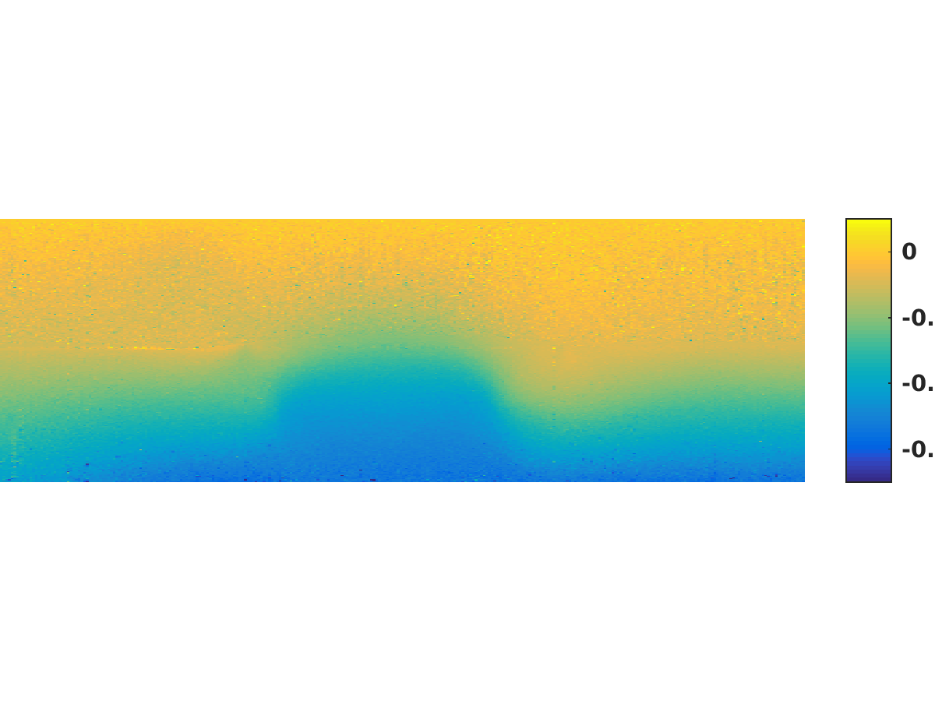
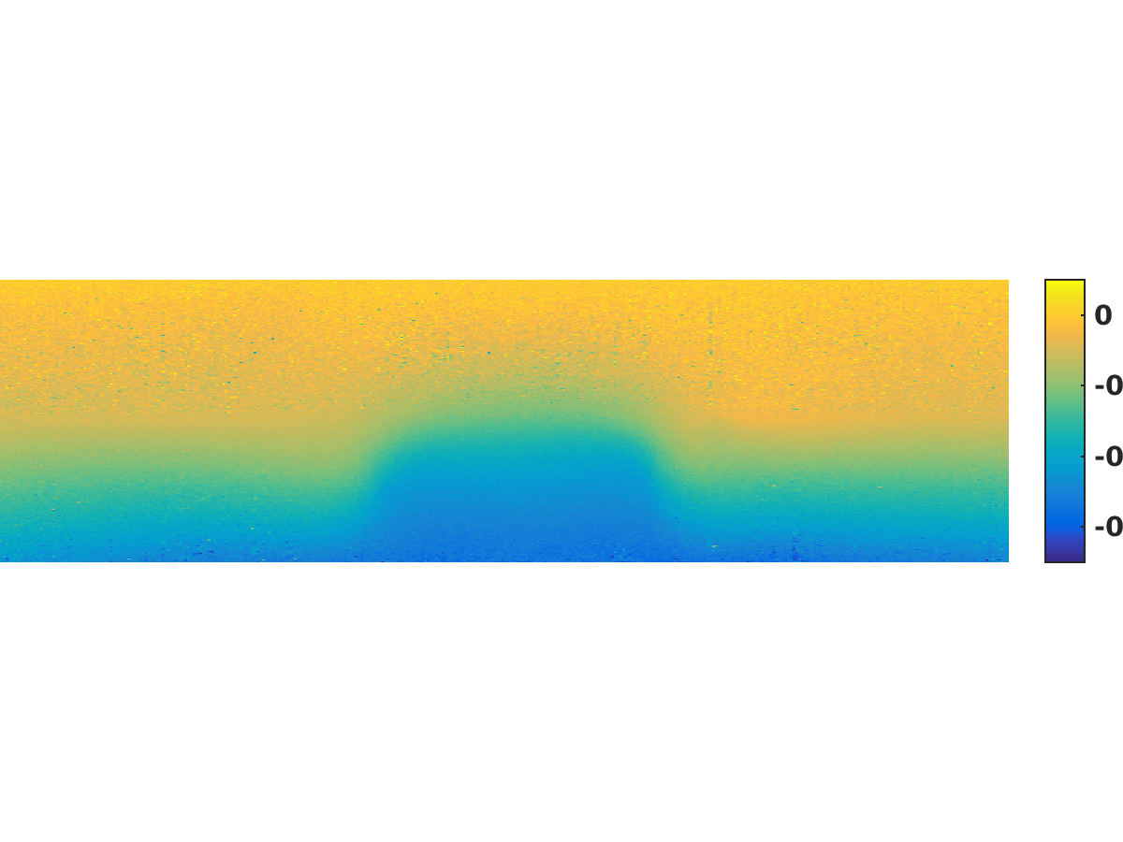
Case III: Tissue-like phantom in 3D
Displacement field ũ
In the OCT experiment,
31.5 million points are sampled in a regular grid.
This results in 157.5 million tetrahedron elements and 15.75 million optimization variables.
Too much and rather unnecessary to work with!
μm
Notes:
Explain displacement plots

Slide 11
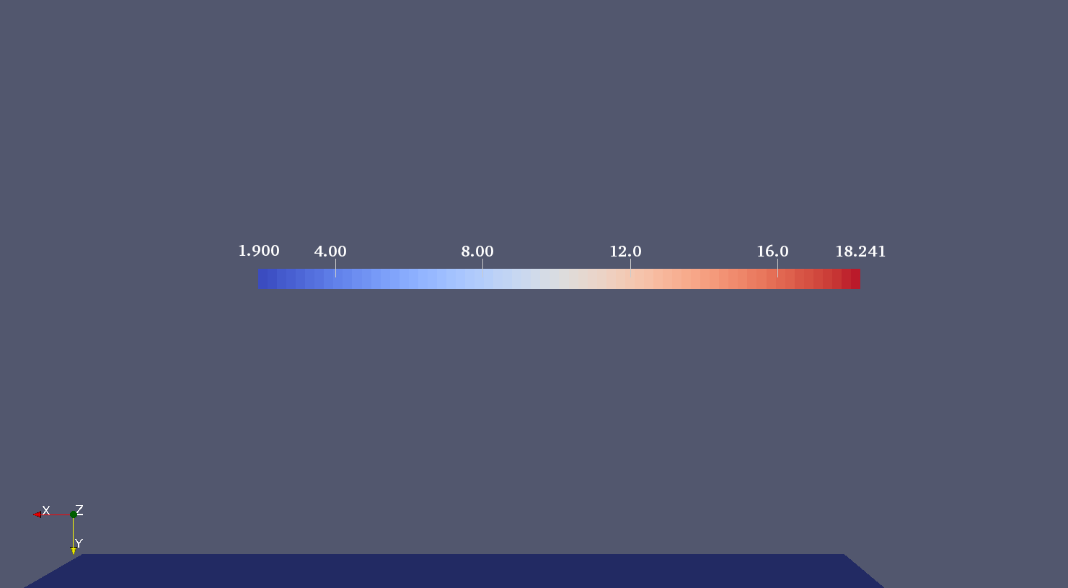
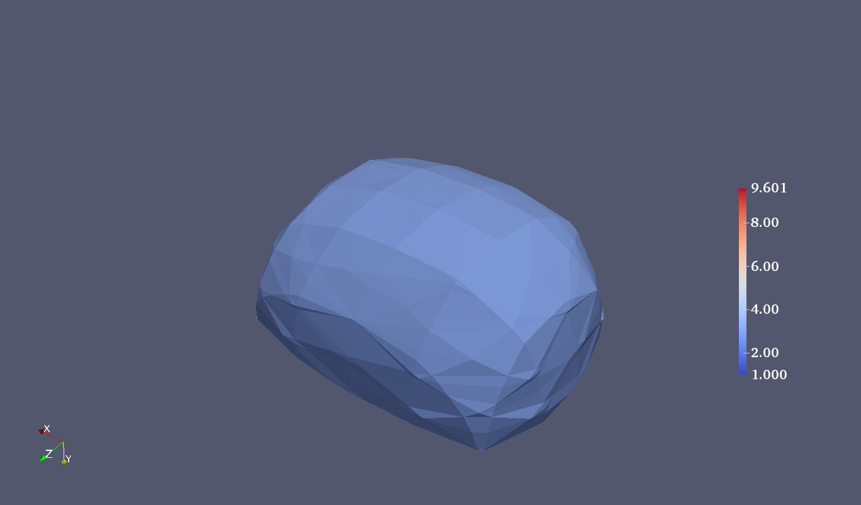
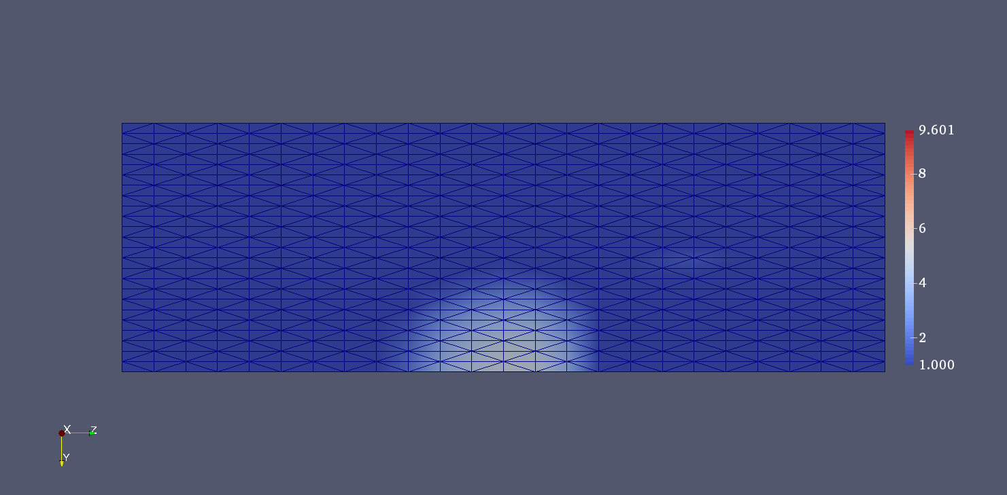
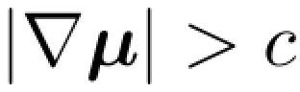
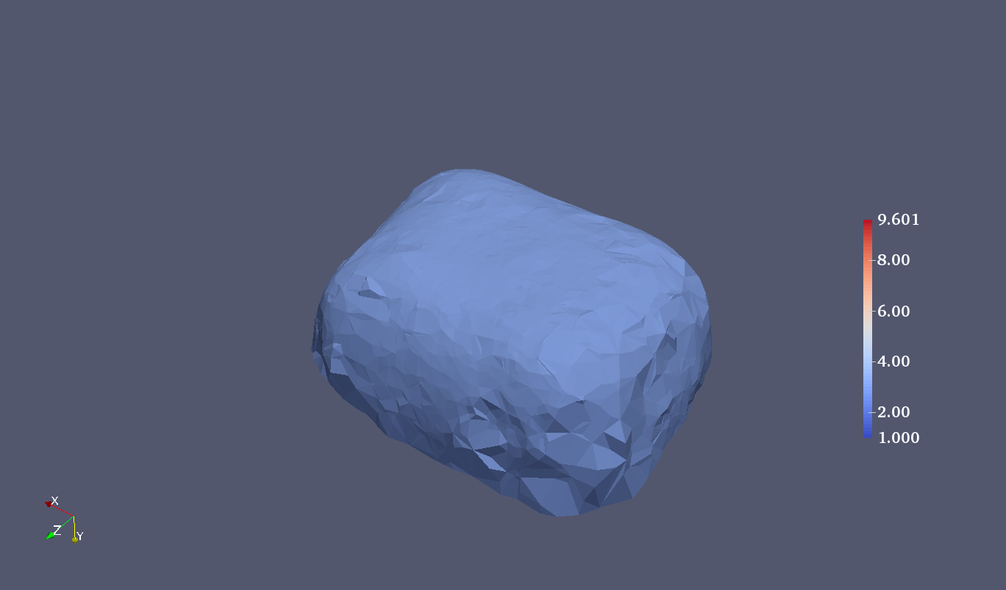
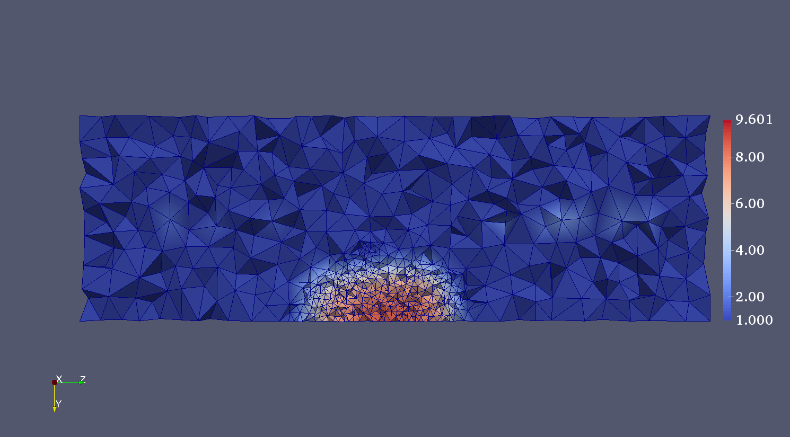
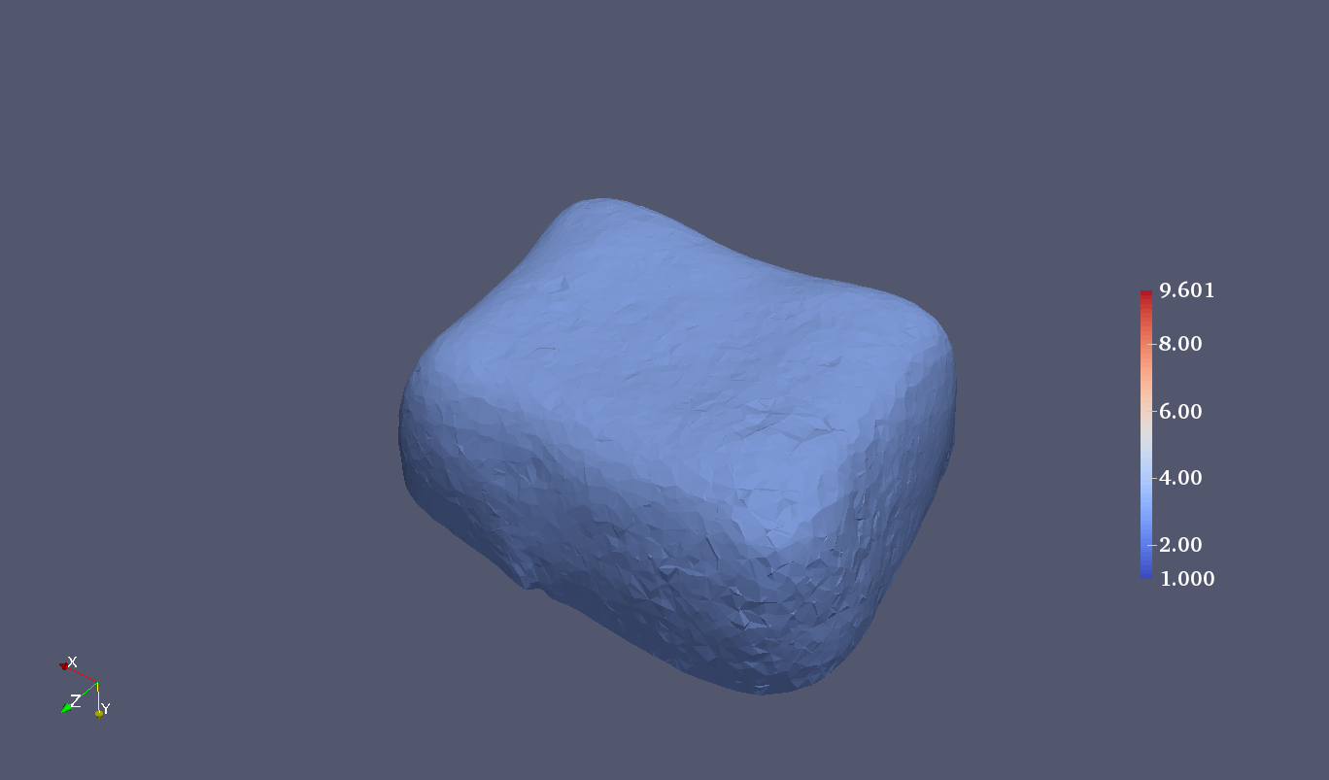
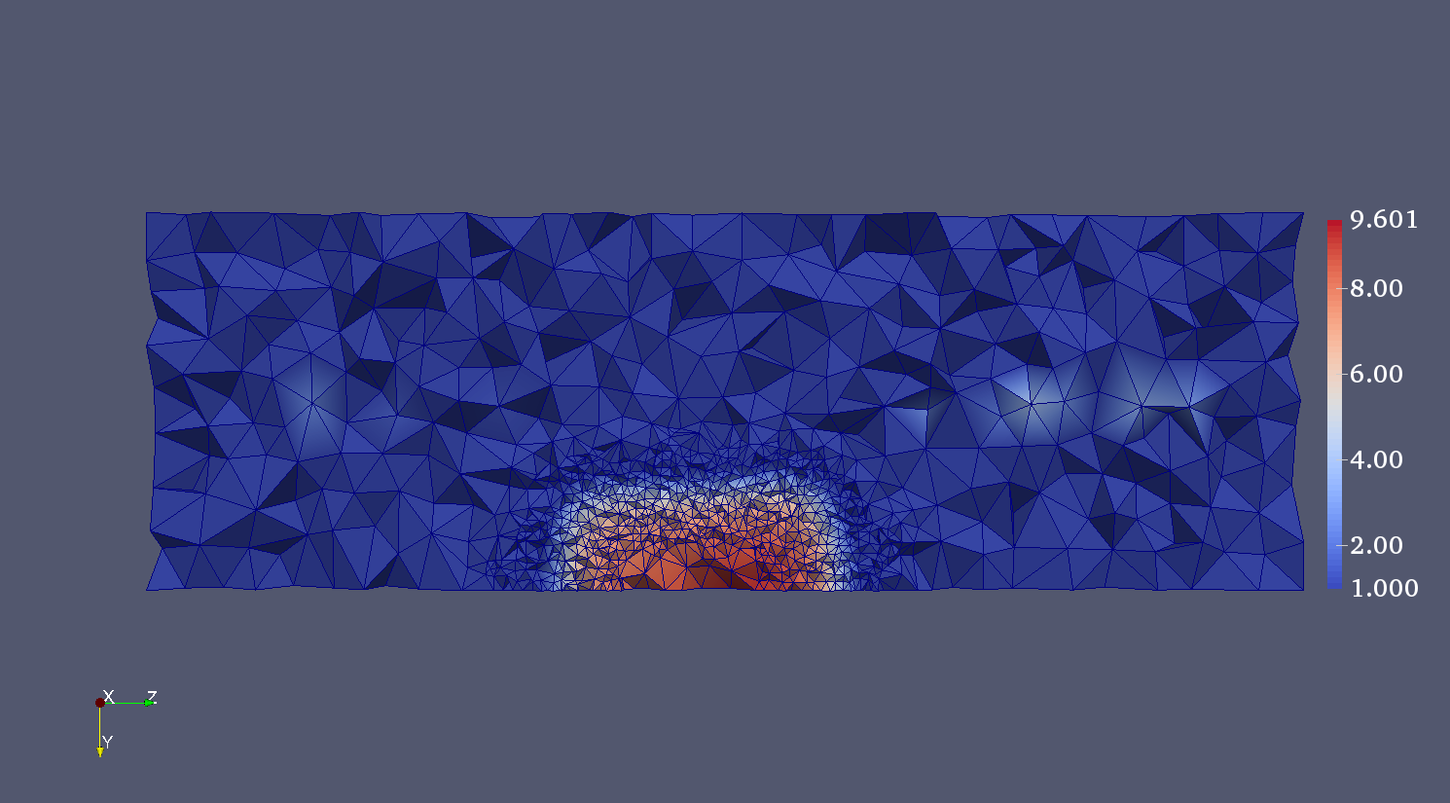
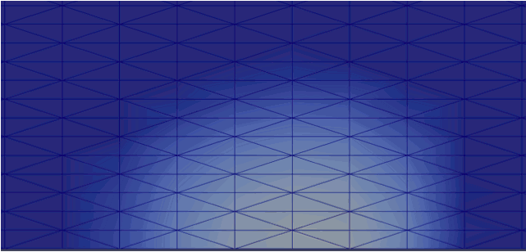
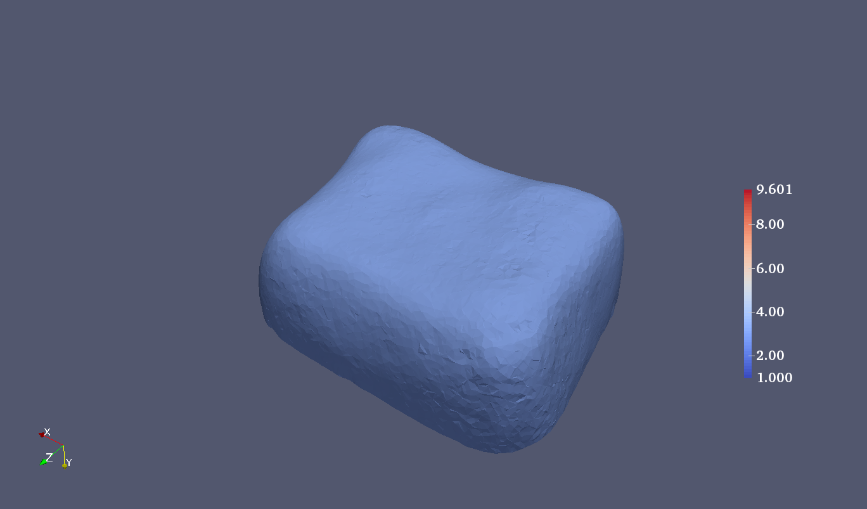
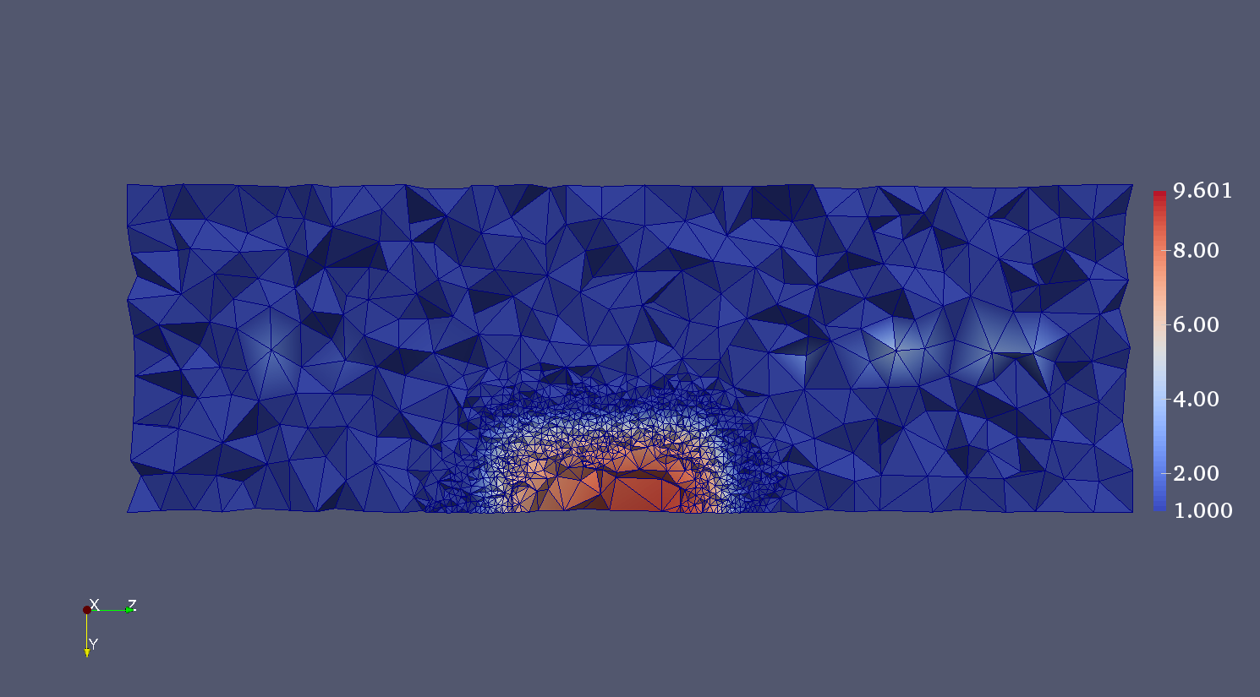
Case III: Tissue-like phantom in 3D cont.
Unpublished work.
Adaptive Mesh
Remeshing ( )
Interpolation
Continuation
# | Points | Elements | Optimization variables
Regular mesh | 31,500,000 | 157,500,000 | 15,750,000
Adaptive mesh | 60,091 | 365,525 | 54,607
Notes:
Remesh the elements that have grad(Mu) > threshold and are below the calibration layer
Interpolate nodal values between different meshes
Use the solution of the previous step as the initial guess of the next step
We deterine mesh size in the next to be inverse proportional to the gradi of mu

Slide 12
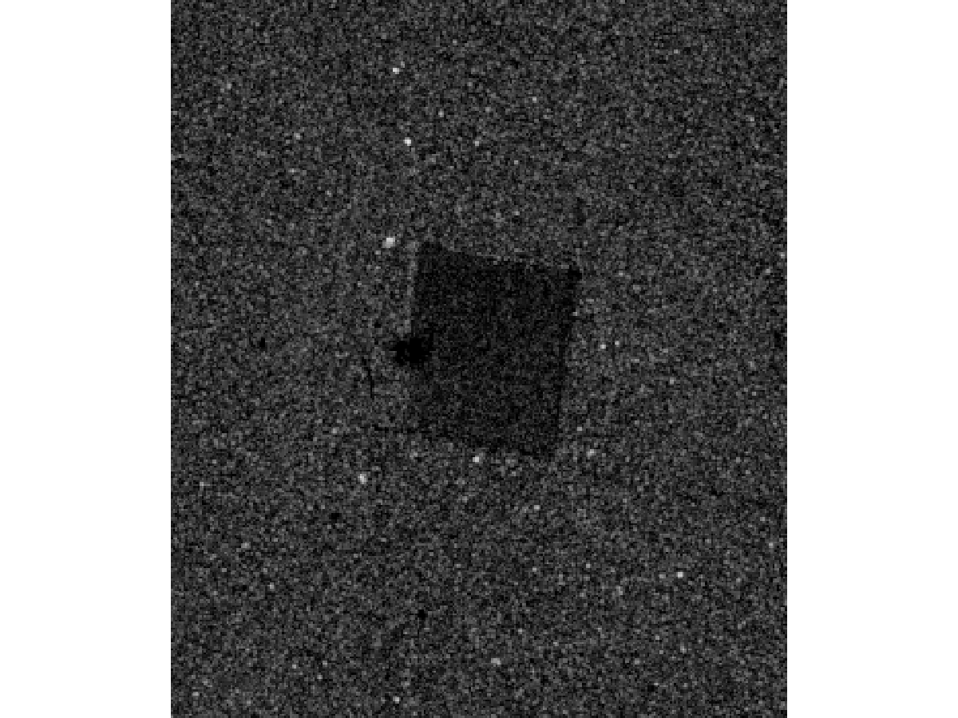
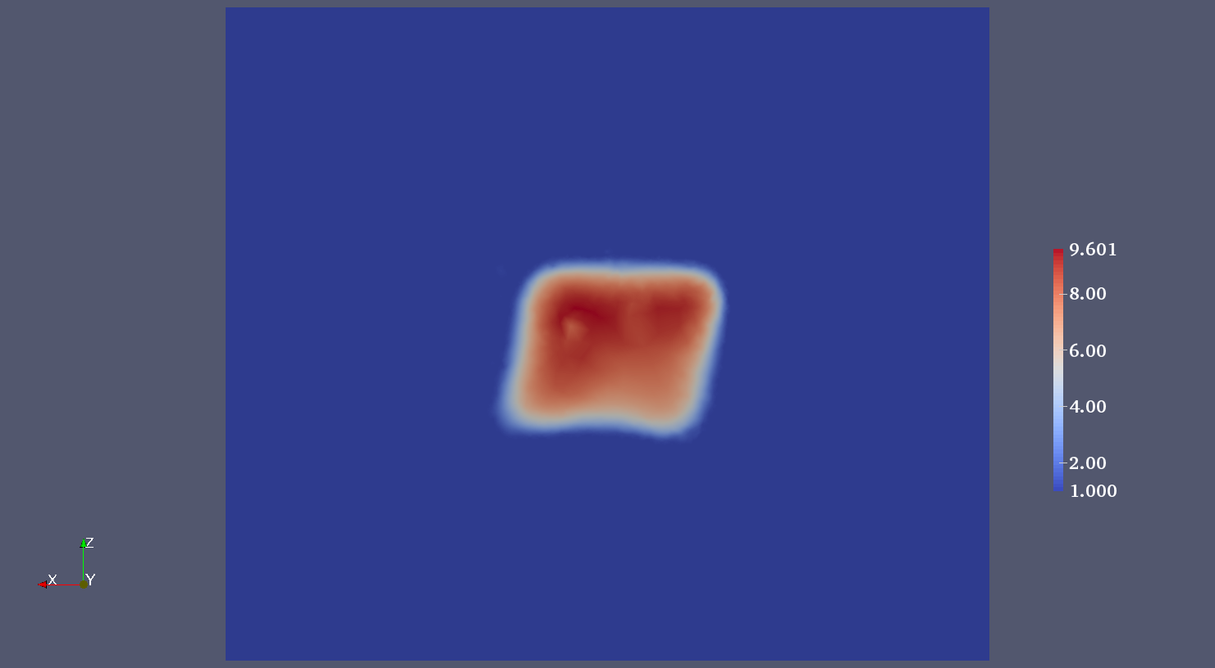
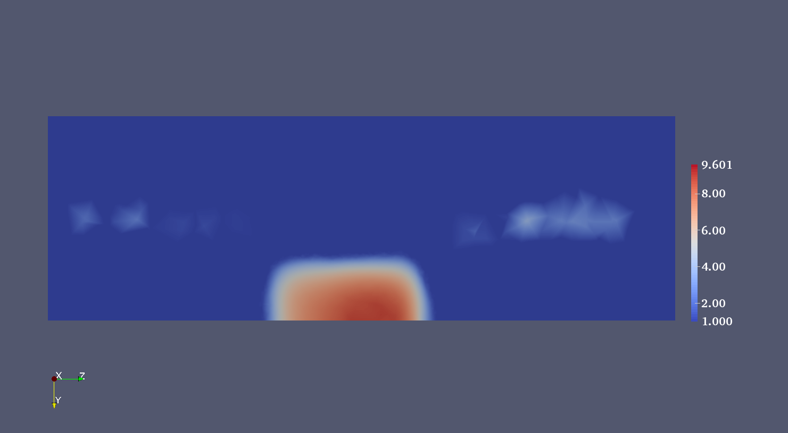




Case III: Tissue-like phantom in 3D cont.
Unpublished work.
1.9 kPa vs 2.3 kPa
1.9 kPa
9.3 kPa vs 10.1 kPa
54,607 optimization variables, terminate after 470 iterations.
Notes:
300x350x300 points, 982x3500x3000 microns, axial by lateral by elevational.
For the 3D inclusion case, it takes about 35 hours with regularization parameter(3e-3) and terminates at 470th iteration.
All results are obtained from the linux platform with 8-core 2.3GHz Opteron processor and 16 GB memory.

Slide 13
Summary
Demonstrate a quantitative OCE method
Compression OCE
Calibration layer
Optimization method
Proper regularization
Adjoint equations
Adaptive mesh
Validate the method against a tissue-like phantom with stiff inclusion in 2D and 3D
Apply the method to an equine bronchus sample
Future work: investigate nonlinear effects, assumptions on boundary conditions, in-vivo tests, etc.

Slide 14





Acknowledgement
Funding agencies: NSF and the National Breast Cancer Foundation in US; University of Western Australia, Australian Research Council and the National Health and Medical Research Council in Australia; Royal Society in UK.
Authors: Li Dong (RPI), Philip Wijesinghe (UWA), James Dantuono (RPI), David Sampson (UWA), Peter Munro (UCL, UWA), Brendan Kennedy (UWA), and Assad Oberai (RPI)
Questions?

